Slide 1


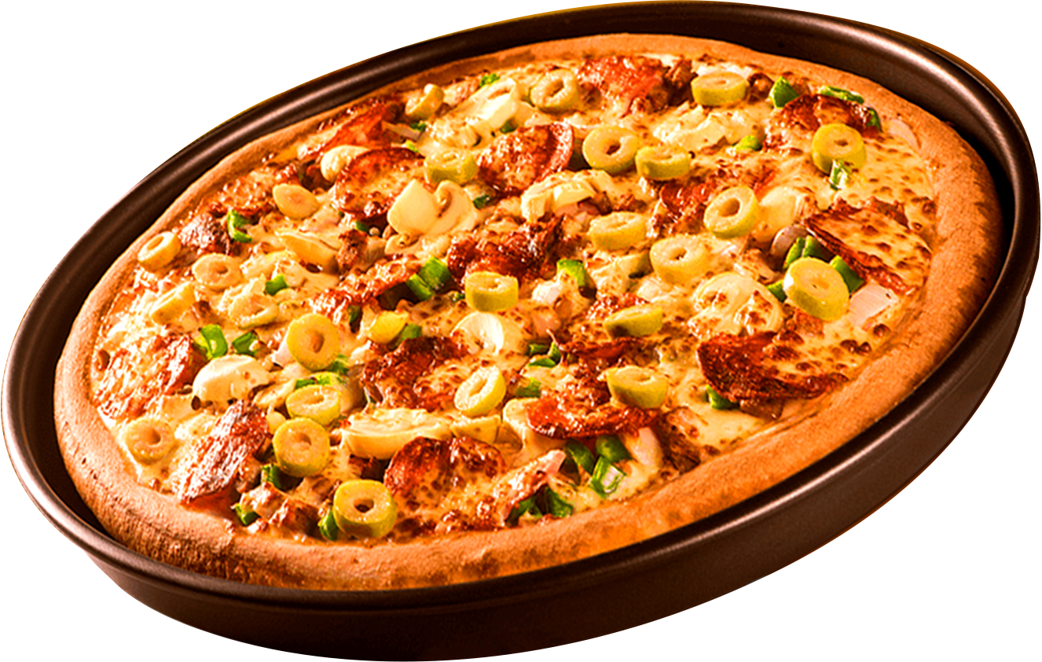
Where Every Slice is a Taste of Perfection
WELCOME TO
PIZZA SALES
ORDER
NOW
Start Your Slide

Slide 2
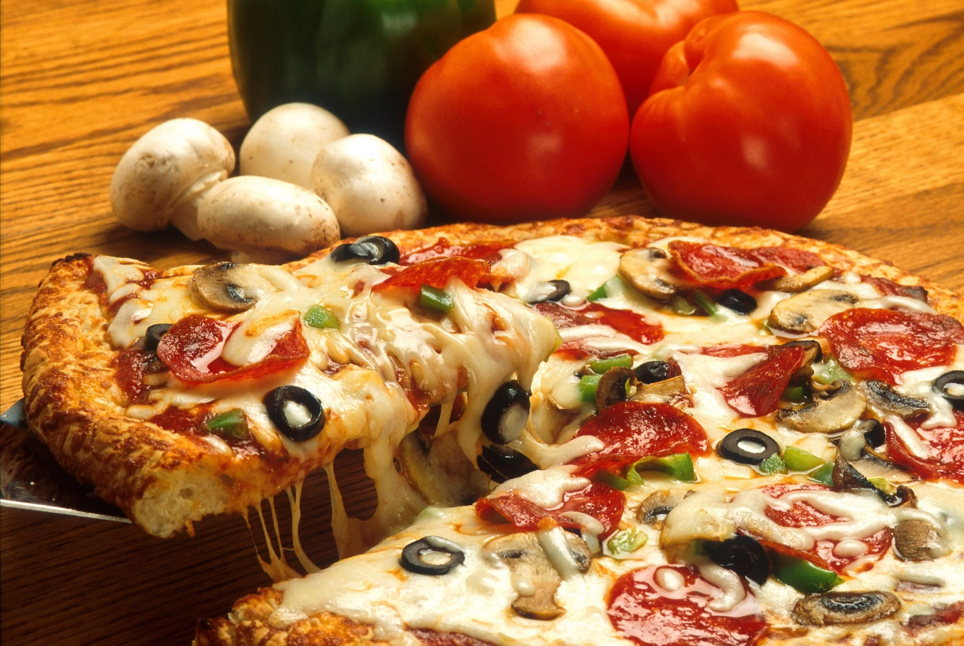

HELLO
Pizza Sales
Rajaselvi here. I’ve done a project by utilizing the SQL queries to solve the question related to pizza sales

Slide 3
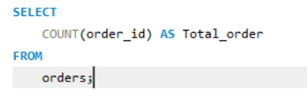
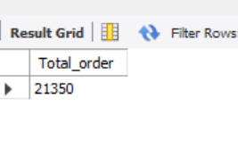
RETRIEVE THE TOTAL NUMBER OF ORDERS PLACED

Slide 4
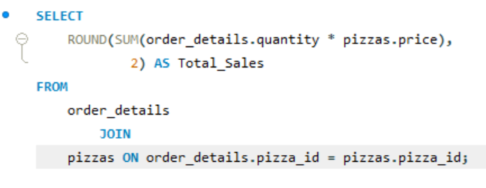
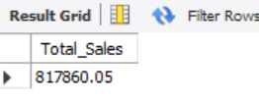
CALCULATE THE TOTAL REVENUE GENERATED FROM PIZZA SALES

Slide 5
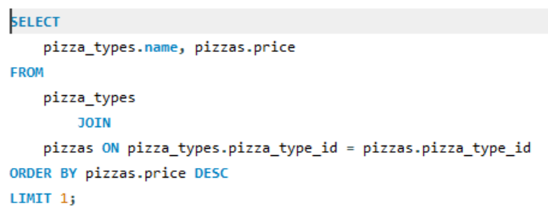
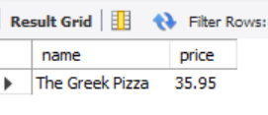
IDENTIFY THE HIGHEST-PRICED PIZZA

Slide 6
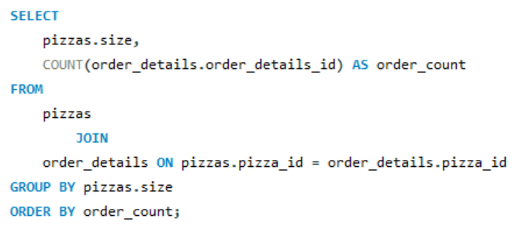
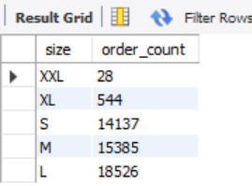
IDENTIFY THE MOST COMMON PIZZA SIZE ORDERED

Slide 7
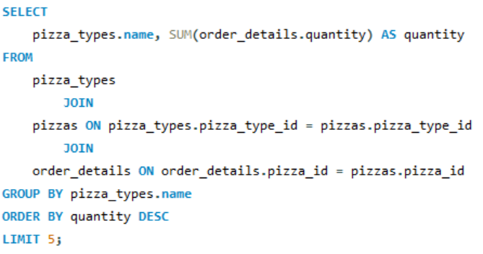
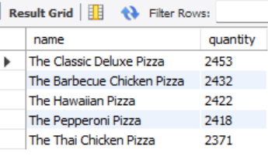
LIST THE TOP 5 MOST ORDERED PIZZA TYPES ALONG WITH THEIR QUANTITIES

Slide 8
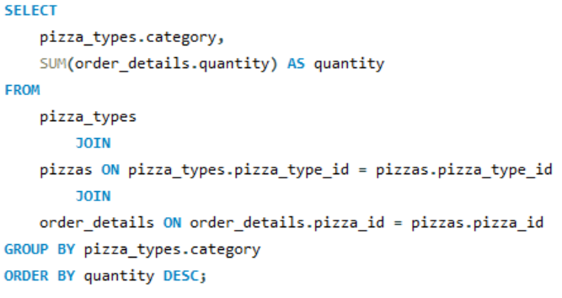
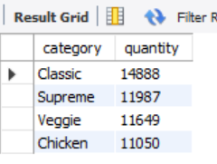
JOIN THE NECESSARY TABLES TO FIND THE TOTAL QUANTITY OF EACH PIZZA CATEGORY ORDERED

Slide 9
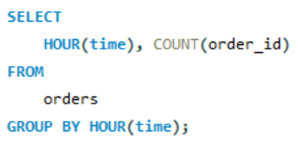
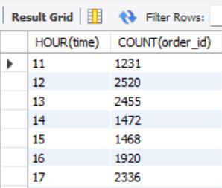
DETERMINE THE DISTRIBUTION OF ORDERS BY HOUR OF THE DAY

Slide 10
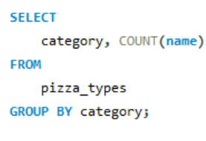
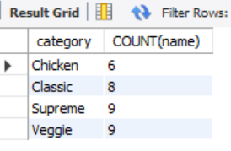
JOIN RELEVANT TABLES TO FIND THE CATEGORY-WISE DISTRIBUTION OF PIZZAS

Slide 11
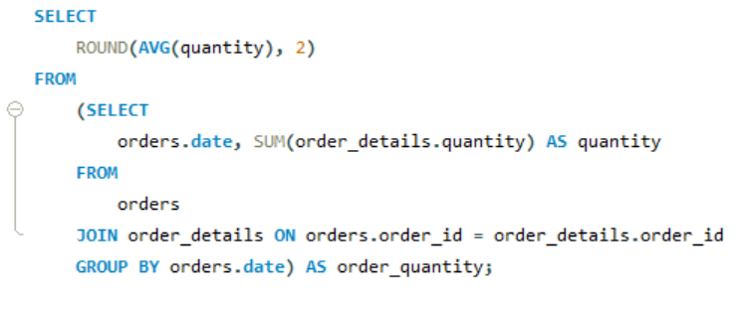
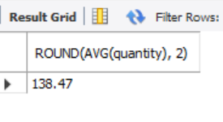
GROUP THE ORDERS BY DATE AND CALCULATE THE AVERAGE NUMBER OF PIZZAS ORDERED PER DAY

Slide 12
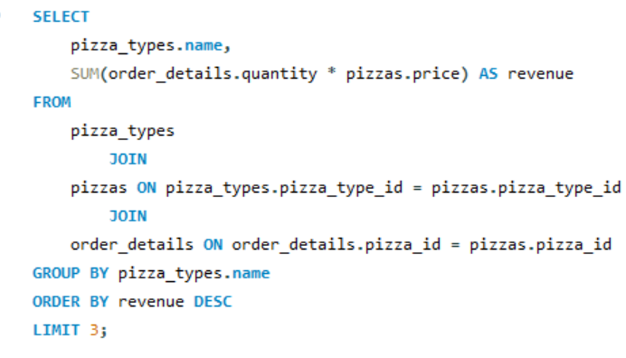
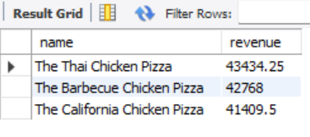
DETERMINE THE TOP 3 MOST ORDERED PIZZA TYPES BASED ON REVENUE

Slide 13
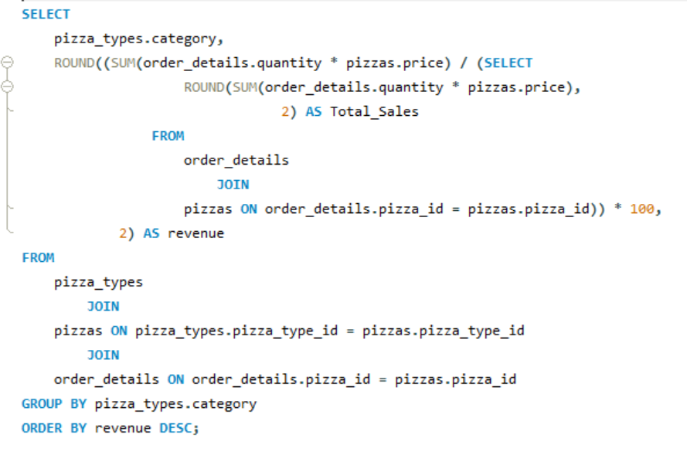
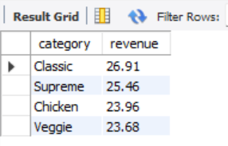
CALCULATE THE PERCENTAGE CONTRIBUTION OF EACH PIZZA TYPE TO TOTAL REVENUE

Slide 14
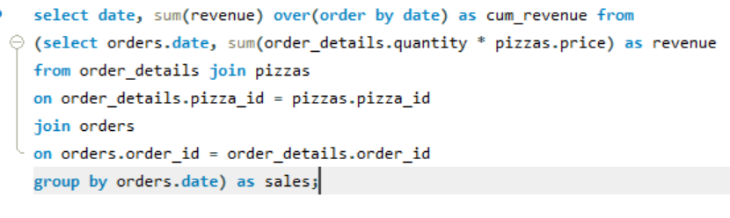
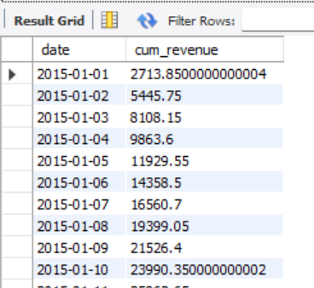
ANALYZE THE CUMULATIVE REVENUE GENERATED OVER TIME

Slide 15
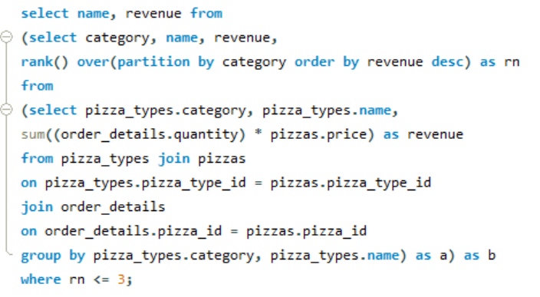
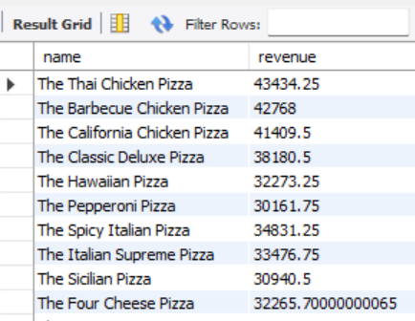
DETERMINE THE TOP 3 MOST ORDERED PIZZA TYPES BASED ON REVENUE FOR EACH PIZZA CATEGORY

Slide 16
Pizza Sales Presentation
THANK YOU
FOR ATTENTION

